Slide 1
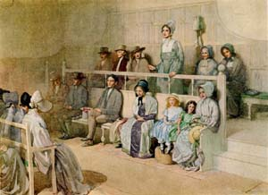
What is a Friends Testimony?

Slide 2
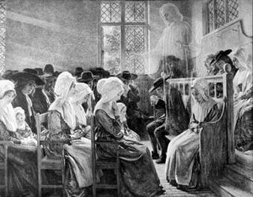
Forgotten
Friends
Testimonies
ELDERS

Slide 3
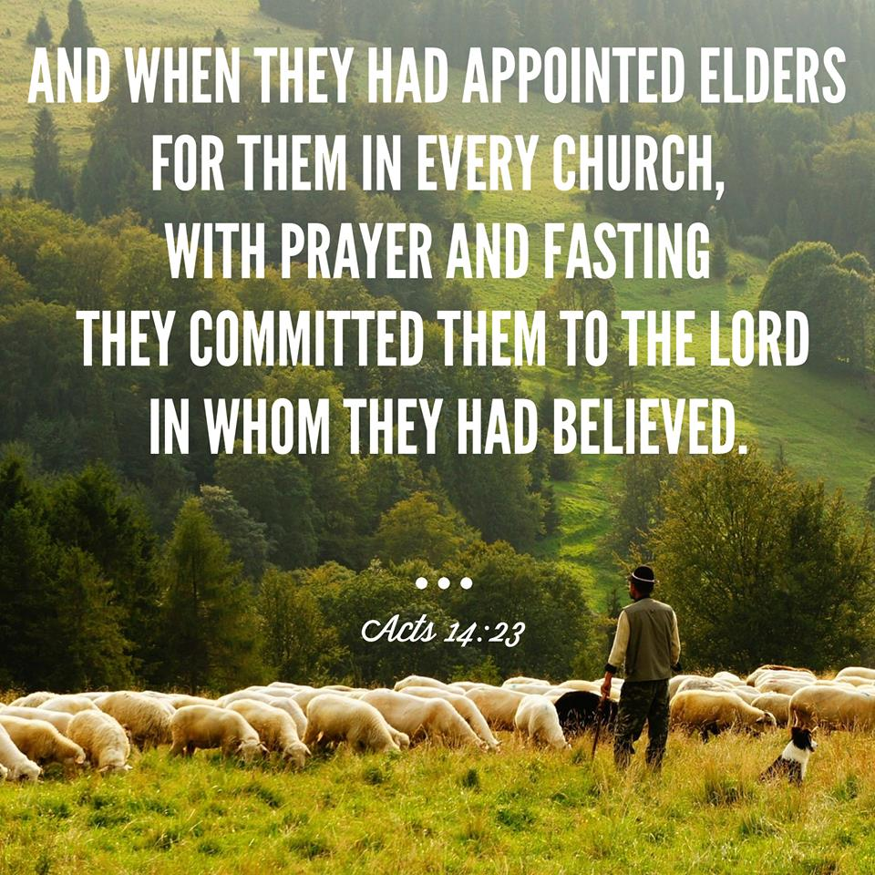

Slide 4
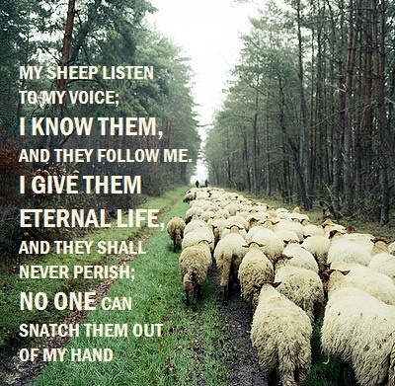
SPIRITUAL NURTURE
OF THE CHURCH
Helping the church
to listen and follow
the voice of Christ Jesus.
John 10:27-28
Acts 20:25-38

Slide 5

But above all he excelled in prayer. The inwardness and weight of his spirit, the reverence and solemnity of his address and behavior, and the fewness and fullness of his words, have often struck even strangers with admiration…truly it was a testimony he knew and lived nearer to the Lord than other men…’ (William Penn of G. Fox) (1963:58)

Slide 6
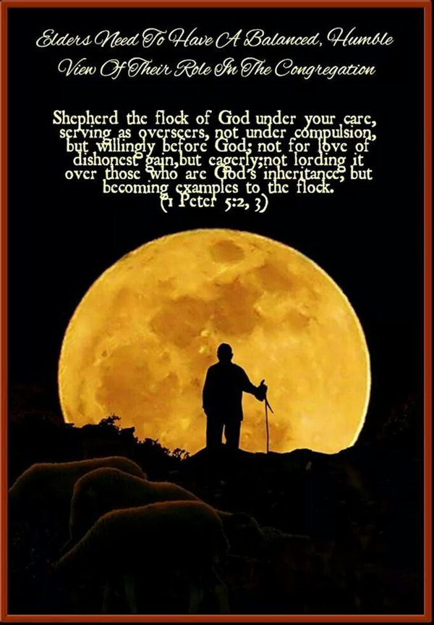
Nurture of Elders—
Prayers for Healing
“Is anyone among you suffering? Then he must pray. Is anyone cheerful? He is to sing praises.
Is anyone among you sick? Then he must call for the elders of the church and they are to pray over him, anointing him with oil in the name of the Lord.
And the prayer offered in faith will restore the one who is sick, and the Lord will raise him up, and if he has committed sins, they will be forgiven him.”
James 5:13-16

Slide 7

Nurture of Elders—
Prayers of Confession & Restoration
Therefore, confess your sins to one another, and pray for one another so that you may be healed. The effective prayer of a righteous man can accomplish much…
My brethren, if any among you strays from the truth and one turns him back, let him know that he who turns a sinner from the error of his way will save his soul from death and will cover a multitude of sins.
[James 5:13-16, 19-20, NASV]

Slide 8
Nurture of Elders
“Speaking the Truth in Love”
Ephesians 4:1-3; 13-14
Until we all attain to the unity of the faith, and of the knowledge of the song of God, to a mature man, to the measure of the stature which belongs to the fullness of Christ. As a result, we are no longer to be children, tossed here and there by waves and carried about by every wind of doctrine, by the trickery of men, by craftiness in deceitful scheming; but speaking the truth in love, we are to grow up in all aspects into Him who is the head, even Christ.
Wm. Penn of George Fox
In his testimony or ministry he much labored to open truth to the people’s understandings, and to bottom them upon the principle and principal, Christ Jesus, the light of the world, that by bringing them to something that was of God in themselves, they might the better know and judge of him and themselves.
He had an extraordinary gift in opening the Scriptures. He would go to the marrow of things, and shew the mind, harmony, and fulfilling of them with much plainness, and to great comfort and edification. (1964:57)

Slide 9
Elders—“High Calling of God”
Elder Leadership Traits
1 Tim. 3:1-7; Titus 1:5-9
Good Reputation
Self-controlled
Hospitable
Full of the Holy Spirit
Wisdom & Discernment
Self-controlled (not given to drunkenness)
Non-violent, Gentle, Not Quarrelsome
Able to Teach & Ministry of Prayer
Manage His Own Family Well
Not a Novice in Their Faith

Slide 10
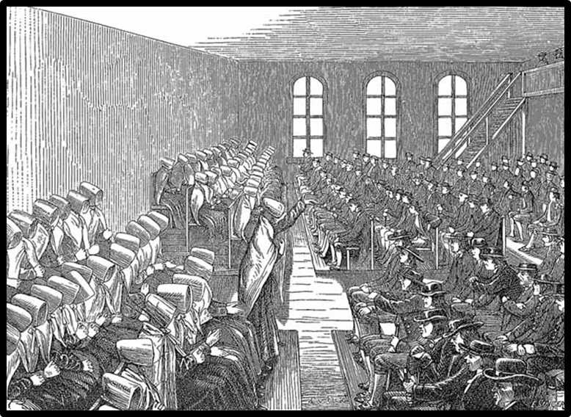
Religious Society of Friends Elders
“They were changed men themselves before they went about to change others.”
--- Wm. Penn

Slide 11
Who are the Friends Elders?
Traditionally Friends have appointed from among their membership persons to serve as Elders of the Monthly Meeting. Elders have been associated with the Pastor in the spiritual care of the Monthly Meeting and given counsel and guidance to the Pastor. Historically Elders have been the persons who exercised a disciplinary oversight of the membership.
Elders are the persons who have grown most in the power and life of the Spirit and who have matured through experience into a position of spiritual leadership. Such persons, dedicated to the Truth, are steadfast in the Christian faith, live above personal reproach, are discerning and wise in spiritual matters and gifted in the graces of the Spirit (Ephesians 4:11-12; Galatians 5:22).
Elders function within the Monthly Meeting be recognizing and encouraging spiritual gifts among members, carrying a spiritual concern for the corporate life of the Monthly Meeting and giving loving and tender guidance to new Christians and those whose way of life is inconsistent with a Christian profession or out of unity with Friends’ principles. (IYM 2011:53)

Slide 12
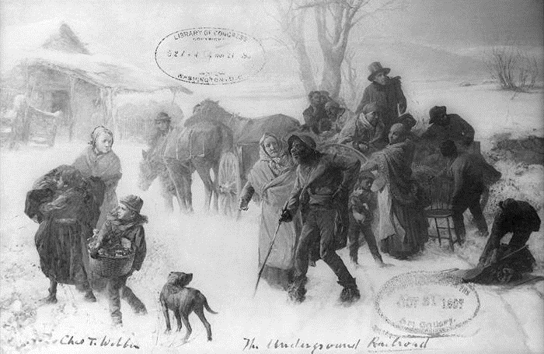
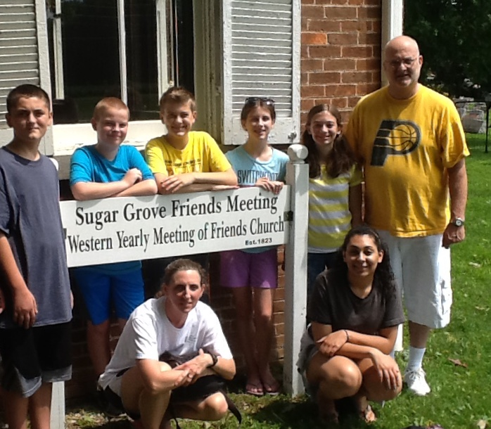
Friends Elders
Robert & Lydia Tomlinson (Westfield Friends)
Were middle aged people; elders for many years, and active in the interests of the church. She, especially, was a leader. Conscientiously in their places at all services of the church, allowing no small matter or ordinary circumstance to interfere with this duty. Deeply interested in the Anti-Slavery movement and conscientious about using slave-labor goods. A journey to Greensboro, Indiana, was sometimes made, where free-labor goods could be obtained, Lydia refusing to purchase a calico dress which was known to have had in it the toil of the slave; and she preferred her coffee without sugar rather than use that coming from the cane-fields of the South. He was a conductor on the underground railroad, and their home was a refuge for many a poor, closely-pursued, runaway slave. (1908:152)

Slide 13
Role of the Friends Elders
IYM
Spiritual Welfare of Meeting & Meeting for Worship (pp. 43, 53, 64)
Prayer & Discernment for the Monthly Meeting
* Membership & Gifts (pp. 64-65)
* Recording of Ministry (p. 65)
* Spiritual Evaluation of Meeting (pp. 66-67)
Relations to Pastor (pp. 44,65-66)
Memorials (p. 66)
Harmonious Relations in the Meeting (pp. 44, 64)

Slide 14
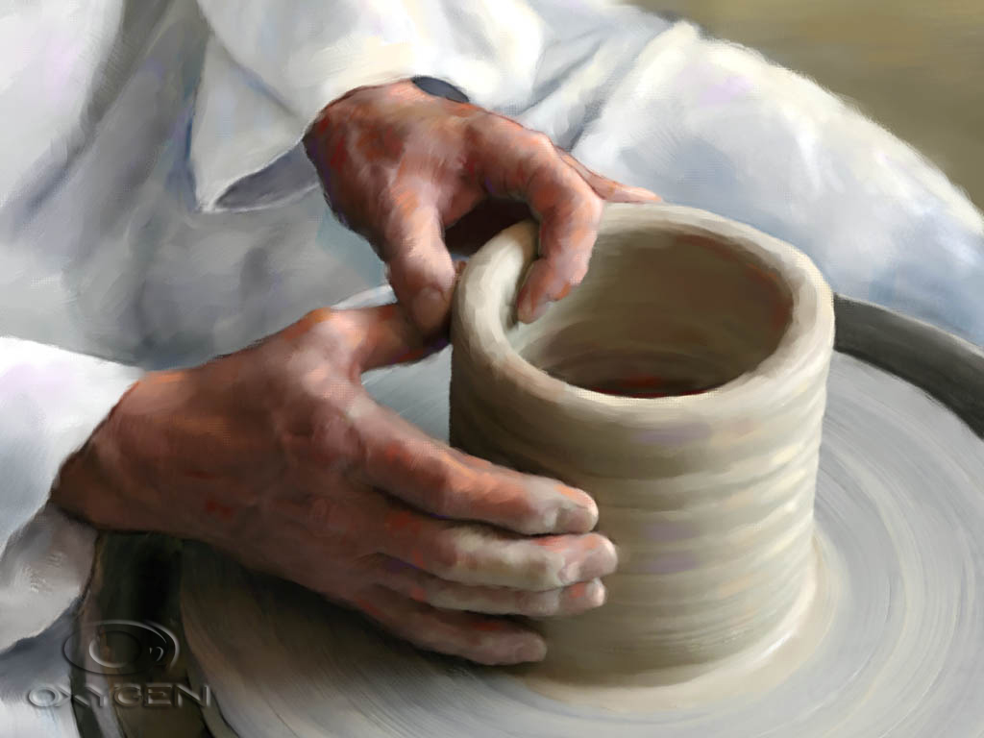
Qualification & Nomination of an Elder
The Nominating Committee of the Monthly Meeting shall annually propose to the Monthly Meeting the names of Adult Members who possess or may develop the capacities of spiritual leadership and ministry for the members and attenders of the Monthly Meeting. These persons should be ones whose lives demonstrate spiritual discernment and dedication to the Truth. They should have a good knowledge and understanding of the Bible, the teachings of Christianity, and the principles and the work of the Religious Society of Friends. Their lives should stand as a testimony to the leadership of the Holy Spirit.
[IYM Faith & Practice, p. 63]

Slide 15
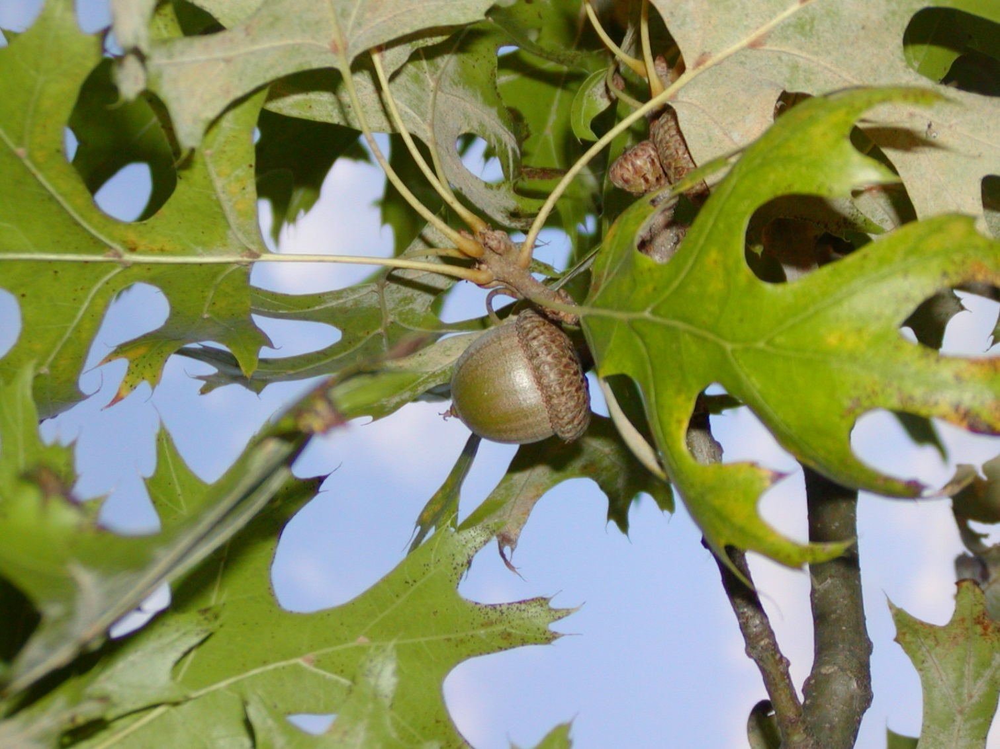
Seed of Faith & Irma Morris

Slide 16
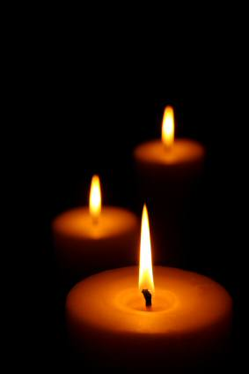
Discussion
Why do you believe the discernment of spiritual qualities in an individual are important for the nomination a Friends Elder?
What is the difference between an elder and a “representative”?
When and how has an “elder” helped you to hear and discern God’s voice?

Slide 17
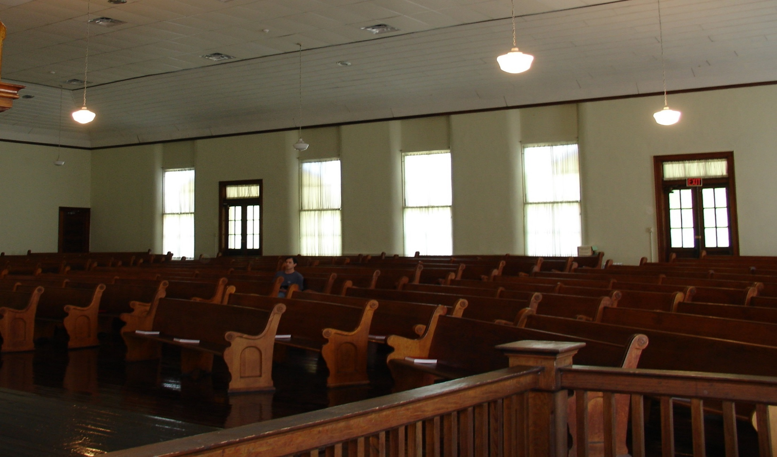
Spiritual Welfare of the Meeting
The Gathering of a Meeting

Slide 18
Gathering a Friends Meeting for Worship
One condition for such a group experience seems to be this: Some individuals need already, upon entering the meeting, to be gathered deep in the spirit of worship.
There must be some kindled hearts when the meeting begins.
In them, and from them, begins the work of worship. The spiritual devotion of a few persons, silently deep in active adoration, is needed to kindle the rest, to help those others who enter the service with tangled, harried, distraught thoughts to be melted and quieted and released and made pliant, ready for the work of God and His Real Presence…
Thomas Kelly, The Eternal Promise, p. 97

Slide 19
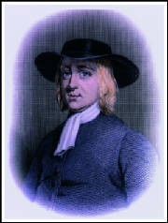
Meeting for Worship
George Fox Pastoral Epistle #344, 1677
Dear Friends, my love in the Lord Jesus Christ to you all..
My desires are, the God of all Peace and the Son of Peace, may fill all your hearts with his Love, Peace, Wisdom and Knowledge in all things, to do his heavenly glorious will, in that you will know his Son’s doctrine; and, as you know it, obey it…
All your Men and Women’s Meetings everywhere, keep in the Power of the Lord Jesus Christ in his Gospel… So that all the faithful men and women may in the Lord’s Power be stirred up in their inheritances of the same Gospel, to labor in it, helps-meets in the Restoration, as Man and Woman was before the Fall in the Garden of God.
[The Power of the Lord is Over All, the Pastoral Letters of George Fox, p. 357]

Slide 20

Membership Clearness
It shall be the duty of the Meeting on Ministry and Counsel to instruct and guide applicants for membership in their search for Truth, to ascertain whether the applicant makes a sincere profession of faith in Christ and accepts the principles of Christianity as held by Friends, and whether he will share in the financial obligations of the Meeting.”
[WYM Faith & Practice, 1955, p. 110]

Slide 21
Discernment
Clearness Committees
Many meetings use clearness committees to help discern the will of God in their lives. A meeting may establish a clearness committee at the request of a member or attender who desires spiritually-sensitive guidance when facing circumstances such as a membership issue, a desire to be married under the care of the meeting, personal decision, or a family needs.
Members or attenders who wish to meet with a clearness committee may make their request to the monthly meeting or to the Board on Christian Ministries and Evangelism/Ministry and Council, either of which may make the appointments.
[WYM Faith & Practice, p. 32]

Slide 22
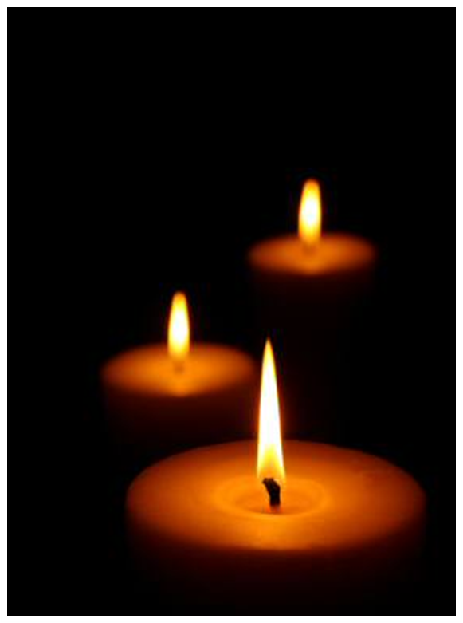
Elder Queries
Do you as elders and ministers recognize your responsibility in setting an example of faithfulness and loyalty to the meetings for worship and business?
Do you accept appointment of this group as a definite response to the “high calling of God in Christ Jesus”?
[IYM Faith & Practice, p. 43]
[WYM Faith & Practice, p. 29]

Slide 23

Ministry & Counsel Queries
Are you always ready to encourage and advise those who engage in the vocal ministry or in other Christian work?
Are you concerned that the needs of all are ministered to in your meetings, whether by silent worship, inspirational speaking or reverent music?

Slide 24
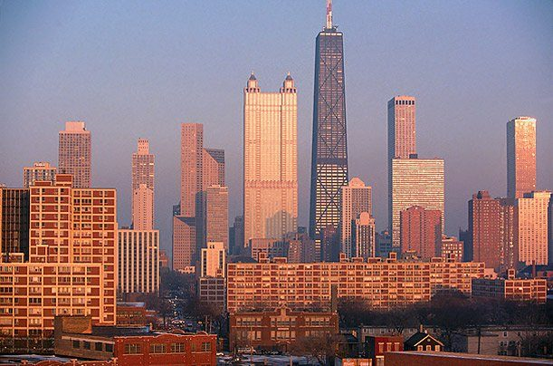
Clearness Process to
FUM Ministry,
The Chicago Fellowship of Friends

Slide 25
Discussion
What role do elders play in your meeting?
How do we gather members into our meetings?

Slide 26
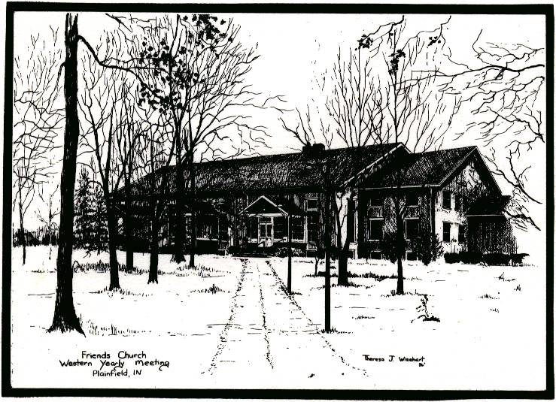
Role of Elders in the Discernment of Meeting for Worship with a Concern for Business

Slide 27
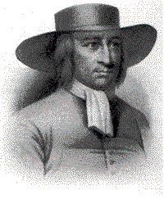
The Spiritual Order of the Gospel
So Friends are not to meet like a company of people about town or parish business, neither in their Men’s nor women’s Meetings, but [they are] to wait upon the Lord and feel his Power and spirit to lead them…
That whatsoever they may do, they may do it to the praise and Glory of God, in Unity in the Faith, in the Spirit, in Fellowship in the order of the Gospel [which] the devil and his instruments cannot get into…
[The Power of the Lord is Over All, the Pastoral Letters of George Fox, p. 312]

Slide 28
Decision Making in the Church
Autocratic
Democratic
Consensus
Discernment
Robert Barclay in his book, Anarchy of the Ranters, based the Friends’ decision making of discernment upon the New Testament Church model found in Acts 15.

Slide 29
Acts 15:6-13
The apostles and elders came together to look into this matter. After there had been much debate, Peter stood up and said to them, ‘Brethren, you know that in the early days God made a choice among you, that by my mouth the Gentiles would hear the word of the gospel and believe. And God, who knows the heart, testified to them giving them the Holy Spirit, just as He also did to us; and He made no distinction between us and them, cleansing their hearts by faith.
Now therefore why do you put God to the test by placing upon the neck of the disciples a yoke which neither our fathers nor we have been able to bear? But we believe that we are saved through the grace of the Lord Jesus, in the same way as they also are.
All the people kept silent and they were listening to Barnabas and Paul as they were relating what signs and wonders God had done through them among the Gentiles.

Slide 30
Acts 15:13- 23a
After they had stopped speaking, James answered, saying, ‘Brethren, listen to me. Simeon has related how God first concerned Himself about taking from among the Gentiles a people for His name. With this the words of the Prophets agree, just as it is written.
After these things I will return, and I will rebuild the tabernacle of David
Which has fallen, and I will rebuild its ruins, and I will restore it.
So that the rest of mankind may seek the Lord,
and all the Gentiles who are called by My name,’ says the Lord, who makes these things known from long ago.
Therefore it my judgment that we do not trouble those who are turning to God from among the Gentiles, but that we write to them that they abstain from things contaminated by idols and from fornication and from what is strangled and from blood. For Moses from ancient generations has in every city those who preach him, since he is read in the synagogues every Sabbath.
Then it seemed good to the apostles and the elders, with the whole church, to choose men from among them to send to Antioch with Paul and Barnabas—Judas called Barsabbas, and Silas, leading men among the brethen and they sent this letter by them…

Slide 31
New Testament Church Discernment
What attributes of discernment decision making are found in Acts 15?
Gathering of Apostles & Elders
Sharing of how the Lord was leading them individually
Unity with Scripture
Silence
James served as the Clerk and stated the “decision minute”
Decision in unity with the Holy Spirit
Minute was circulated among the churches

Slide 32
Monthly Meeting for Business Queries
Are all meetings for worship and for business duly held, and are you regular and punctual in attending them?
Do you come with heart and mind prepared for communion with God and fellowship with one another?
Do you individually assume your rightful share in the responsibility and work and worship of the meeting?
Are your meetings for business times of spiritual concern and prayerful search for the way of truth?
[WYM Faith & Practice, p. 28]

Slide 33
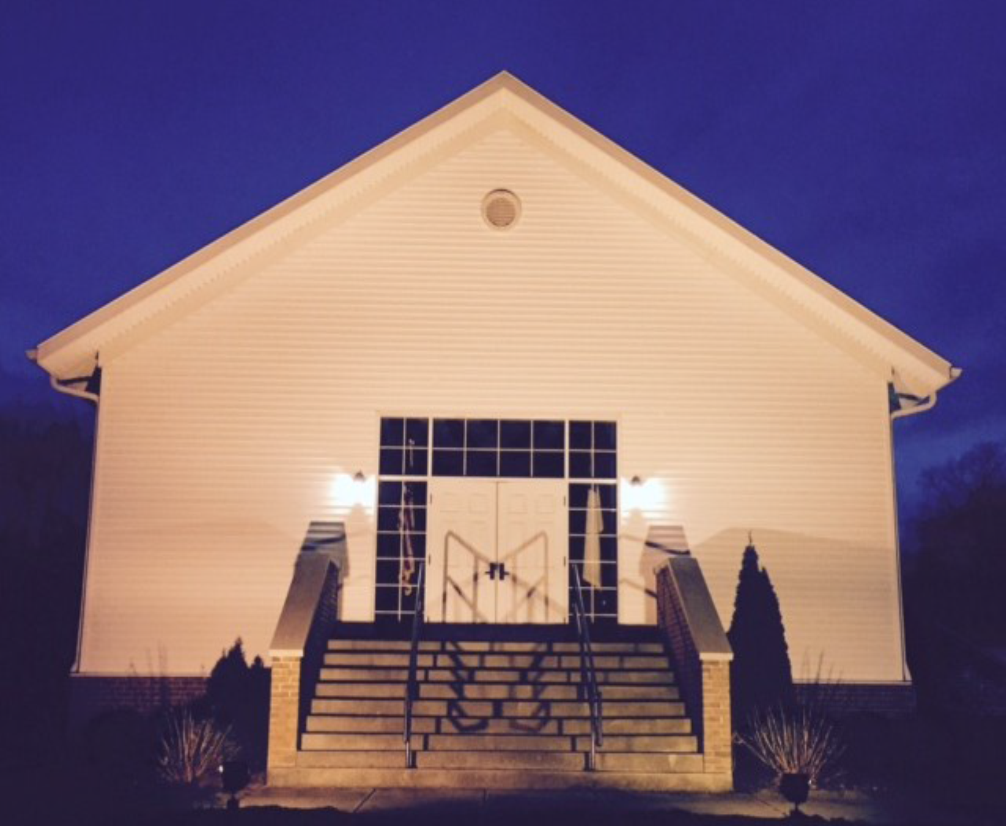

Slide 34
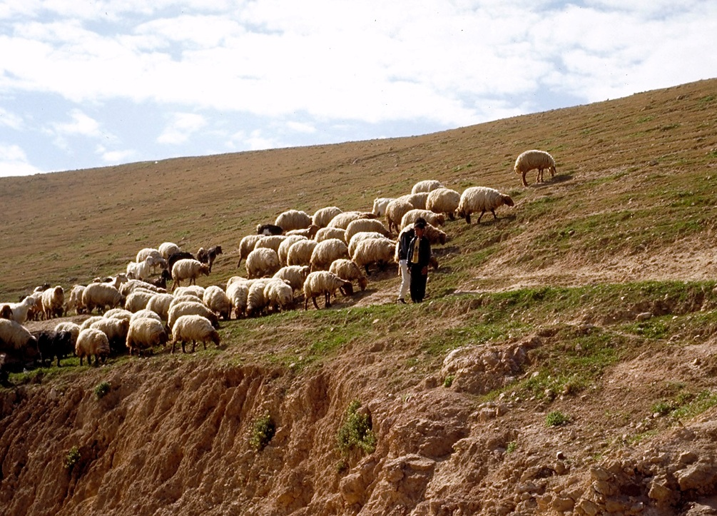
Elder
A Noun & A Verb—Testimony of Restoration

Slide 35

Restoration
“Through the Flaming Sword”
“Now I was come up in spirit through the flaming sword, into the paradise of God. All things were new; and all the creation gave unto me another smell than before, beyond what words can utter. I knew nothing but pureness, and innocency, and righteousness; being renewed into the image of God by Christ Jesus, to the state of Adam, which he was in before he fell. The creation was opened to me; and it was showed me how all things had their names given them according to their nature and virtue.” (1976:97)

Slide 36
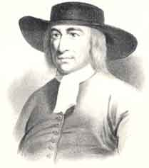
Restoration
& Authentic Community
Friends, all that are sensible of the Power of God…
Live in it and grow up in it. For the Power of God is over the power of the devil, which Power of God is the Gospel and it is called the Cross of Christ… Take your possession of the same. In it keep your Men’s and Women’s Meetings…
For Christ [who] redeemed his people out of their vain conversation, purchased them with his blood and is become the Head of the Church. The heavenly and spiritual Man has given them a heavenly and spiritual possession and Order to walk in, to keep in…to wit, the everlasting Gospel, the Power of God, which I am not ashamed of…. “for it is the Power of God unto Salvation, to everyone that believes.” [Rom. 1:16]
[George Fox Pastoral Epistle #313,

Slide 37
Gospel Order & Peacemaking in the Church
Matthew 18:15-20
If your brother sins, go and show him his fault in private; if he listens to you, you have won your brother.
But if he does not listen to you, take one or two more with you, so that by the mouth of two or three witnesses every fact may be confirmed.
If he refuses to listen to them, tell it to the church; and if he refuses to listen even to the church, let him be to you as a Gentile and a tax collector.
Truly I say to you, whatever you bind on earth shall have been bound in heaven; and whatever you loose on earth shall have been loosed in heaven.
Again I say to you, that if two or you agree on earth about anything that they may ask, it shall be done for them by My Father who is in heaven.
For where two or three have gathered together in My name, I am there in their midst.

Slide 38
Matthew 18
Care of children, 18:1-11
Seek the lost, 18:12-14
Prayer—Gathered Meeting with Christ Present in the Midst; 18:15-20
Restoration & Forgiveness; 18:21-35
“For where two or three
are gathered
together in My name,
I am
there in the midst of them.”
[Matthew 18:20]

Slide 39
Margaret Fell--Discernment
Glory and honor be unto His holy name forever, who has sent His only begotten Son in the likeness of sinful flesh, and for sin, condemned sin in the flesh. As by one man’s disobedience many were made sinners, so by obedience of One shall many be righteous…
Therefore, it is good for everyone to have a true testimony of this eternal Spirit, which believes not every spirit, but tries them, whether they be of God, and proves all things, and holds fast that which is good…
Here is the mystery of the fellowship of the gospel, which is in the unity of the Spirit, which is the bond of peace…
(1992:58, 59)

Slide 40
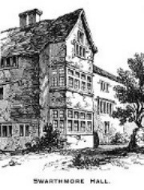
Margaret Fell –Acts 18
“In Acts 18, you may read how Aquila and Priscilla took unto them Apollos and expounded unto him the way of God more perfectly, who was an eloquent man and mighty in scriptures. Yet, we do not read that he despised what Priscilla said, because she was a woman, as many do now.” (1992:67-68)

Slide 41

The Incendiary Fellowship—
D. Elton Trueblood
“The miracle of the early Church was a partial fulfillment of Christ’s
expressed purpose about setting the earth on fire…”
“What we know is that it was the incendiary character of the early Christian fellowship which was amazing to the contemporary Romans and it was amazing precisely because there was nothing in their experience that was remotely similar to it. Religion they had in vast quantities, but was nothing like this…”
“The metaphor of the fire would be meaningless without the fellowship, because it has no significance fore merely individual religion, as it has none for merely ceremonial religion. Though it is, of course, impossible to have a committed Church with uncommitted members; the major power never appears except in a shared experience. Much of the uniqueness of Christianity, its original emergence, consisted of the fact that simple people could be amazingly powerful when they were members one of another. As everyone knows, it is almost impossible to create fire with one log, even if it is a sound one, while several poor logs may make an excellent fire if they stay together as they burn. The miracle of the early Church was that of poor sticks making a grant conflagration. A good fire glorifies even its poorest fuel…”

Slide 42
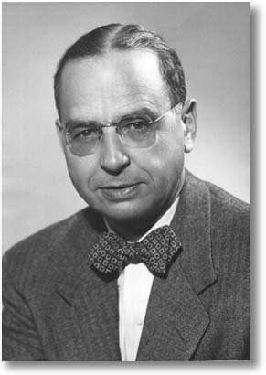
Restoration—
Being a Redemptive Fellowship
The church is the gathered community, the household of faith, the regular coming together of ordinary men and women who are fathers and mothers and holders of jobs. It is because of the peculiar idea of the church as a redemptive fellowship that the characteristic physical structure of Christianity is not a temple or a wayside shrine, but a meetinghouse.
The more we study, the more we realize that Christ’s emphasis upon the saving fellowship is really unique among the religions of the world. The emphasis upon the gathered community as the major unit is not matched in other faiths and is only partially seen, in advance of the Christian Era, in the prophetic development of the synagogue of the Jewish dispersion. Before Christ’s coming the characteristic religious experience of most of those of the pagan world was that of solitariness before the shrine rather than that of two or three together. When the Apostle Paul noted in Athens, that the people were very religious, he was not referring to any evidence of an experience similar to that of a church gathered week by week, but rather to the altars to which men and women made pious visits one by one. [The Yoke of Christ, 1958, p. 32]

Slide 43
“Eldering” Queries
Are you aware of the necessity of harmonious relations with your fellow members as a basis for the most effective service to the Church?
Do you as leaders of the meeting strive earnestly to win men to Christ and to strengthen the faith and loyalty of fellow Christians?
[WYM Faith & Practice, 2005, p. 30]

Slide 44
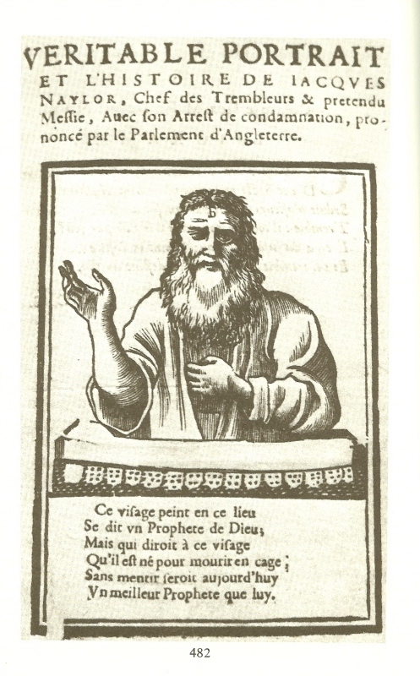
Eldering—When Friends Outrun Their Guide
John Perrot
Wilkinson-Story
Separation
James Naylor
1656 – Arrived in Bristol Imitating Christ’s Arrival in Jerusalem

Slide 45
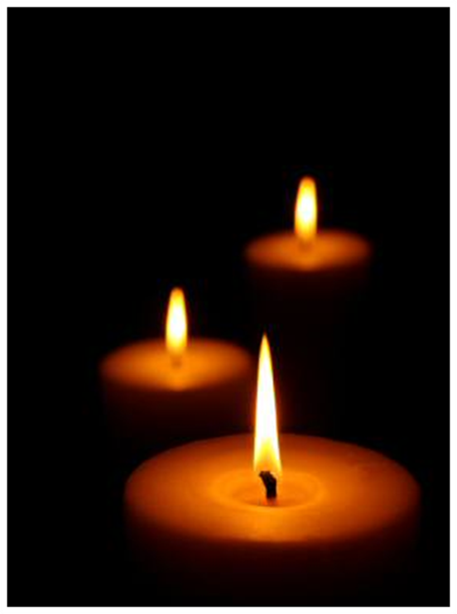
Discussion
What do you think it means to be a “redemptive fellowship”?
How do elders strengthen restoration, faithfulness and peacemaking in your meeting?
Do you have a testimony of “nursing fathers and mothers” within the Religious Society of Friends?

Slide 46
https://youtu.be/16GBYoRWrMI
How do we keep new people in our meetings from being spiritual orphans?

Slide 47
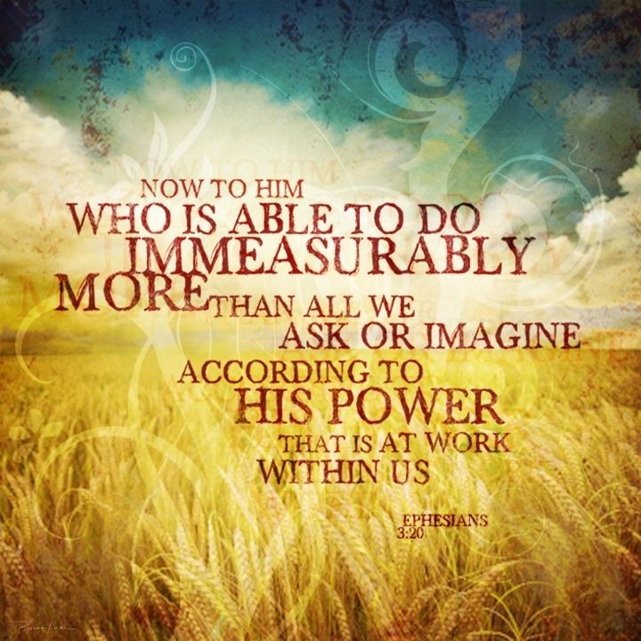

Slide 48
Bibliography
Braithwaite, William C., The Second Period of Quakerism, London: Macmillan & Co.,
1919.
Faith & Practice of Indiana Yearly Meeting of the Religious Society of Friends, 2011.
Faith and Practice of Western Yearly Meeting of Friends Church 2005.
Jones, T. Canby, The Power of the Lord is Over All, The Pastoral Letters of George Fox, Richmond, IN: Friends United Press, 1989.
Jones, Rufus, Ed., The Journal of George Fox, Richmond, IN:
Friends United Press, 1976.
Semi-Centennial Anniversary Western Yearly Meeting of Friends
Church, Plainfield, IN: Publishing Association of Friends, 1908.
Trueblood, D. Elton., The Incendiary Fellowship. New York, NY: Harper & Row, 1967.
Wallace, T.H.S., Ed., A Sincere and Constant Love, Richmond,
IN: Friends United Press, 1992.
Williams, Walter R., The Rich Heritage of Quakerism. Newberg, OR: Barclay Press,
1962.

